Slide 1
Detection of Key Points on Face Images and Recognizing Emotion Using Deep Learning
EEL 6825 : Pattern Recognition
Nishant Agarwal
UFID :61991874
University of Florida

Slide 2
Outline
Problem Statement
Existing Approaches
Proposed Approach
Evaluation Results
Demo
Conclusion

Slide 3
Problem Description
Humans possess a natural ability in understanding facial emotions.
Recognizing emotions without human intervention has become an important area of research for Scientists.
Emotion Recognition has its applications in education and gaming, where algorithms have been devised to estimate learners emotional state to create adaptive learning process.
With the introduction of Big data engineering , availability of ample customer information, emotions can aid the process of customizations.

Slide 4
Problem Description Continued.
The problem statement is quite complicated due to the presence of high variance in the facial features among individuals.
The problem can be categorized into two phase:
Phase 1: Feature Extraction and key facial point detection.
Phase 2: Classification into seven emotion categories of Angry, Disgust, Fear, Happy, Sad, Surprise and Neutral.

Slide 5
Existing Approaches
Use of 10 fold cross validation, SVM classifier along with preprocessing of images including PCA has shown decent accuracy.
Combining auditory and visual reception and using these hybrid multi modal information in detecting correct emotional state.
Researchers have proposed an architecture called Google Net, a 27 layered CNN which is trained using stochastic gradient descent.
The drawback of these model lies in the difficulty in training these models.

Slide 6
Proposed Approach
The Emotion detection model proposed is divided into two phases:
Phase 1 : Automatic feature extraction and facial key point detection using 4 layer Convolution Neural Network.
Phase 2 : Emotion detection using a 4 layered CNN with transfer learning.
A 5 fold cross validation SVM model has been implemented to compare the results from different models.

Slide 7
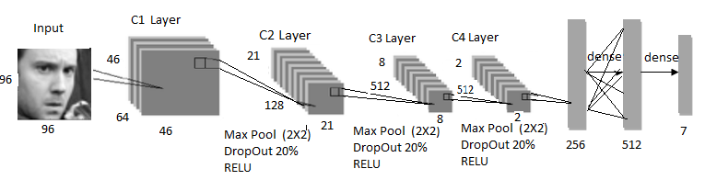
Proposed Approach cont…
PHASE 1:
Dataset: 7049 training and 1783 test grey scale images of 96X96 dimension and coordinates for 15 key points.
CNN Architecture:

Slide 8
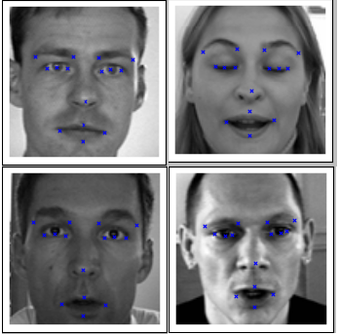
Proposed Approach cont…
Results achieved from phase 1 :

Slide 9
CNN Layers Explained
RELU Layer: Increases non linearity of the network and simplifies the gradient computation and expressed as f(x)=max(0,x)
MAX POOLING Layer: Performs non-linear down sampling along the dimensions of the input image. It divides the image into non overlapping rectangles of given size and considers only the maximum from the sub region.
Loss Layer: This layer penalizes the model by comparing the difference between the true and predicted labels. We have used softmax classifier as the last layer.

Slide 10
CNN Layers Explained
Fully Connected Layer: This layer uses the high-level features extracted during the convolutional and pooling layers and classifies the input image.
Dropout layer: The dropout layer is introduced to prevent overfitting.

Slide 11
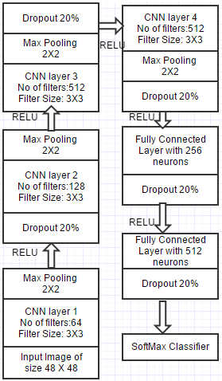
Proposed Approach cont..
PHASE 2
Dataset : 35887 grayscale images of 48X48 dimensions
Data Augmentation: To increase the variability in the training samples, training data were augmented by flipping the images along the vertical axis.
CNN network:

Slide 12
Transfer Learning
Process by which a pre trained model is used as an initialization or feature extractor for the task in hand.
As a feature extractor, the last fully connected layer is removed from the pre-trained model and passed through the new dataset.
Second strategy, call for replacing the classifier for the new data set and fine tuning the weights of the pre trained model by backpropagation.

Slide 13
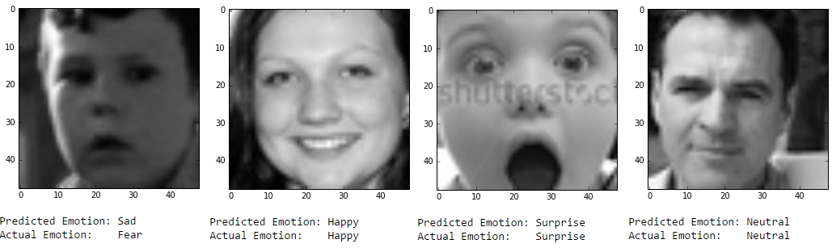
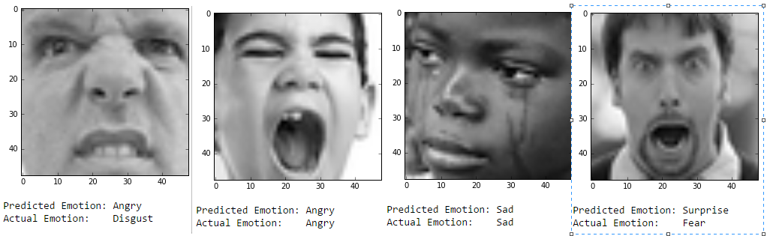
Proposed Approach cont…
The Final Results from the CNN classifier:

Slide 14
DEMO
LETS MOVE TO THE DEMO

Slide 15
Evaluation Results:
RMSE was used as the Evaluation metric for Phase 1.
RMSE score was 1.78
Summary of the accuracy for different models in phase 2:
Model Type | No of Epochs | Data Augmentation | Accuracy | Transfer Learning
SVM | - | No | 32% | No
CNN | 100 | No | 46% | No
CNN | 100 | Yes | 55% | No
CNN | 50 | Yes | 60% | YES

Slide 16
Results from State of Art Models
Model Type | Accuracy
Google Net (27 layer CNN) | 91%
SVM (10 fold cross validation) | 87%

Slide 17
Conclusion
The FER 2013 data used for the project was a relatively tougher dataset having a resolution of only 48 X 48 with presence of inherent noise.
The accuracy of the CNN model achieved from the FER2013 data set is close to human accuracy.
The results proved that the use of transfer learning helped achieve better results.

Slide 18
THANK YOU

